Slide 1
A Complete Processor

Slide 2
Overview
A complete processor consists of several interconnected units that work together to execute instructions efficiently. The main components include:
- Instruction Unit
- Integer and Floating-Point Units
- Instruction and Data Caches
- Bus Interface
- System Bus connected to Memory and I/O

Slide 3
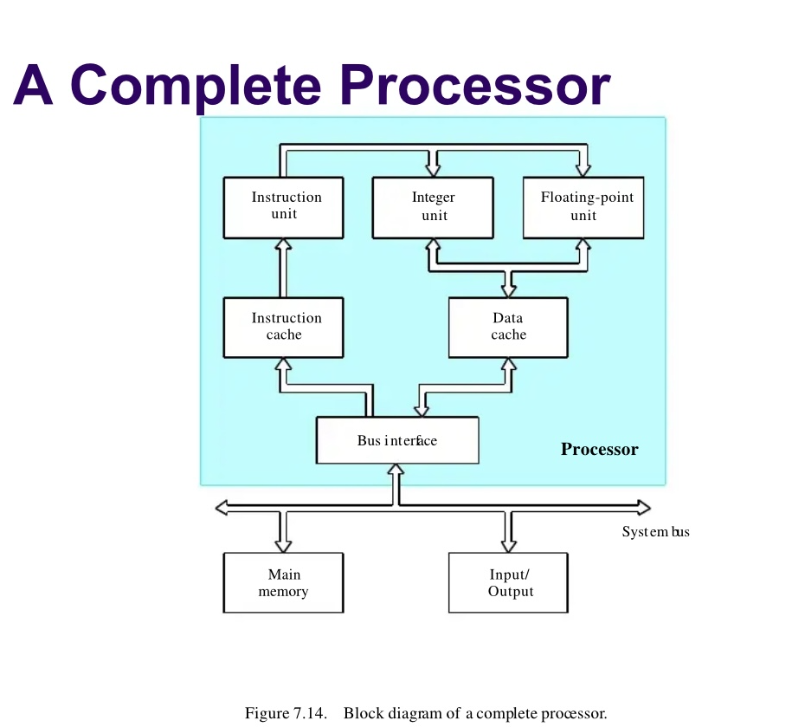

Slide 4
Instruction Unit
The Instruction Unit fetches program instructions from the Instruction Cache.
If an instruction is not found in the cache, it is fetched from Main Memory.
It coordinates the execution of instructions by directing other processing units.

Slide 5
Processing Units
There are two main types of processing units:
  1. Integer Unit: Handles operations on whole numbers.
  2. Floating-Point Unit: Handles operations on decimal (real) numbers.
High-performance processors may have multiple units of each type for concurrent execution.

Slide 6
Data Cache
The Data Cache temporarily stores frequently accessed data.
It reduces the time taken to retrieve data from Main Memory.
Acts as a bridge between the Processing Units and Main Memory.

Slide 7
Bus Interface and System Bus
The Bus Interface connects the Processor to the System Bus.
The System Bus links the Processor, Main Memory, and Input/Output devices.
Ensures smooth data transfer between all units.

Slide 8
Key Points
Separate instruction and data caches improve processor performance (Harvard Architecture).
Unified cache designs store both instructions and data together.
Multiple processing units enable parallel processing, increasing execution speed and efficiency.

